Slide 2

How To Be A Starbucks Barista
By Koleman Parsley
“Redirect Notice.” Google, Google, www.google.com/imgres?imgurl=https%3A%2F%2Fqph.ec.quoracdn.net%2Fmain-qimg-58b8aee066ab040b3790f65dc3047853&imgrefurl=https%3A%2F%2Fwww.quora.com%2FWhat-is-the-meaning-and-story-behind-the-Starbucks-logo&h=568&w=602&tbnid=0DZLEkh-W-CJuM%3A&tbnh=160&tbnw=169&usg=__P81whxw7ECOV2iq2IjxCLRgfVYA&vet=10ahUKEwjwk4Wk9MbWAhVD3mMKHRB9DI0Q9QEILDAA..i&docid=k6RwvMvSazFC-M&sa=X&ved=0ahUKEwjwk4Wk9MbWAhVD3mMKHRB9DI0Q9QEILDAA.

Slide 4
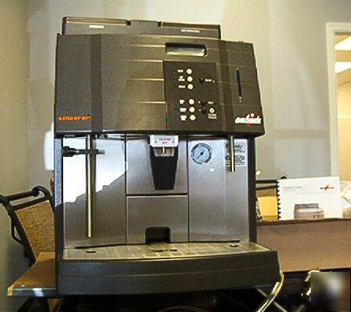
Verismo 701 espresso machine

Slide 6
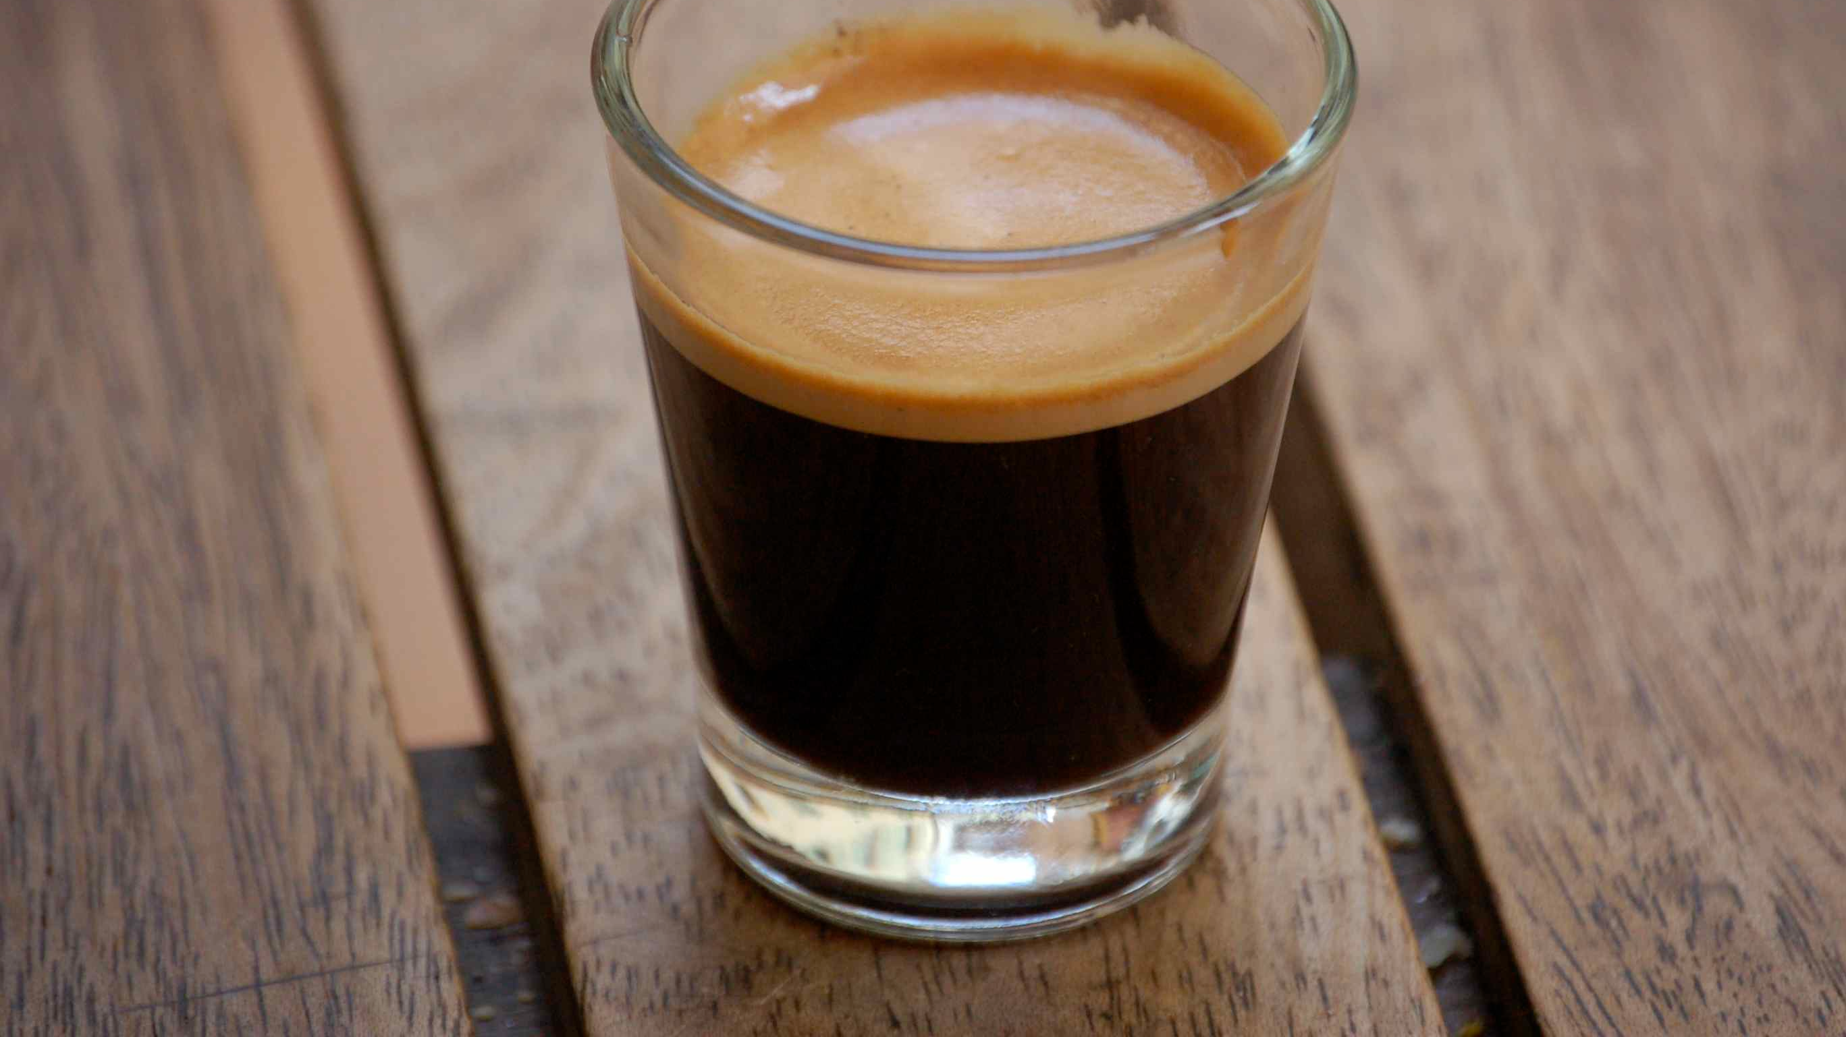
What is Espresso
Heart
Body
Crema
“Blog - History of Espresso Coffee.” Coffee, www.coffee.net/blog/History/.

Slide 8
Ingredients In Drinks
size | Tall | Grande | Venti
Espresso | 1 Shot | 2 shots | 2 shots
Syrup | 2 pumps | 3 pumps | 4 pumps

